Slide 1

DEUTERONOMY

Slide 2
DEUTERONOMY
LXX ~ deuteronomion
Also it shall be, when he sits on the throne of his kingdom, that he shall write for himself a copy of this law in a book, from the one before the priests, the Levites.
Hebrew ~ these are the words
Deuteronomy 17.18

Slide 3
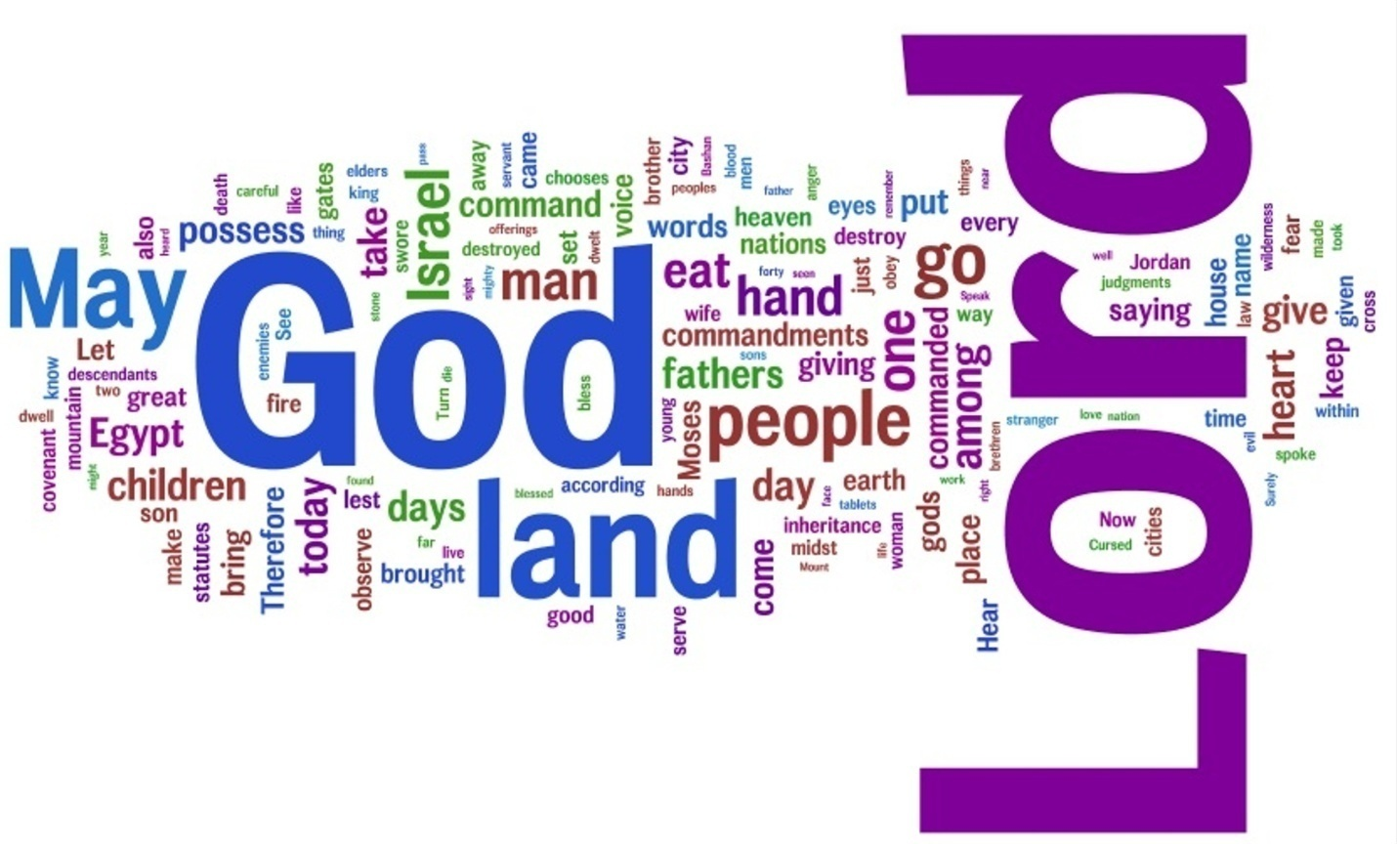
DEUTERONOMY
Key words:
Law (25x)
Love (over 20x)
Land (almost 200x)

Slide 4
DEUTERONOMY
Outline (6 parts):
Chapters 1-4
1st sermon
Chapters 5-26
2nd sermon
Chapters 27-28
3rd sermon
Chapters 29-30
4th sermon
Chapters 31-33
Moses’ final words
Chapters 34
Death and burial of Moses

Slide 5
DEUTERONOMY
5th book of “Pentateuch”
Hebrews: “Torah”
Genesis
Exodus
Leviticus
Numbers
Deuteronomy

Slide 6
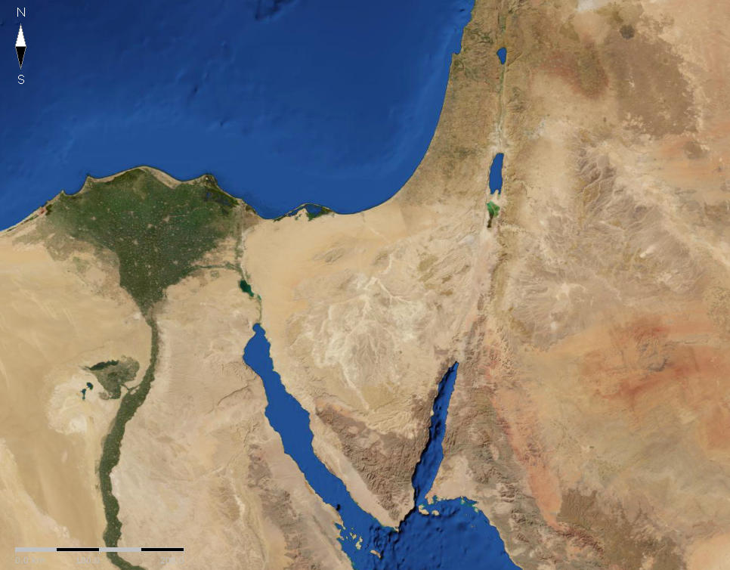
DEUTERONOMY
Mt. Seir

Slide 7
DEUTERONOMY
Shema
One ~ echad, not yacheed (singular)
And you shall love the Lord your God with all your heart, with all your soul, with all your mind, and with all your strength. This is the first commandment.
Mark 12.30

Slide 8
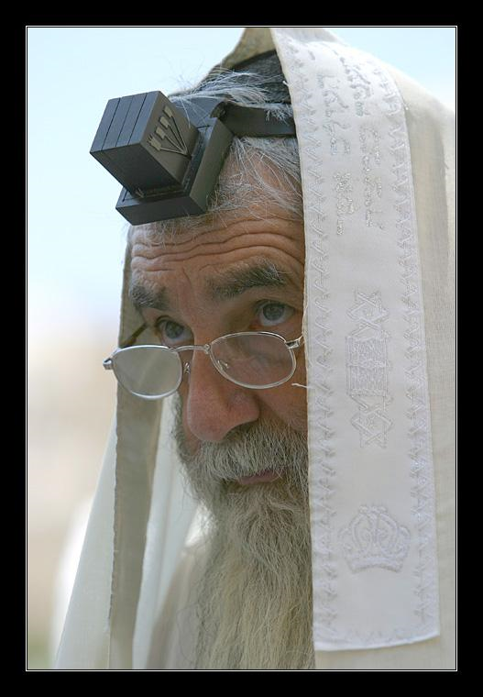
DEUTERONOMY
Teach ~ whet, hone

Slide 9
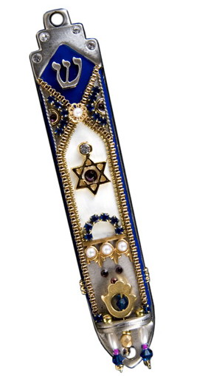
DEUTERONOMY
Doorposts ~ mezzuzah

Slide 10
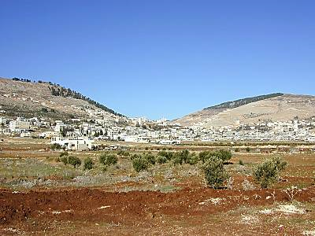
DEUTERONOMY
Gerizim
(Cursings)
Ebal
(Blessings)
Shechem

